Slide 1
Week 1-2

Slide 2
Things to update
Modify graph part
Add new parameters such as number of tomatoes, average size, volume, average leaf, number of ripeness etc
Get size and volume of tomatoes using size detection

Slide 3
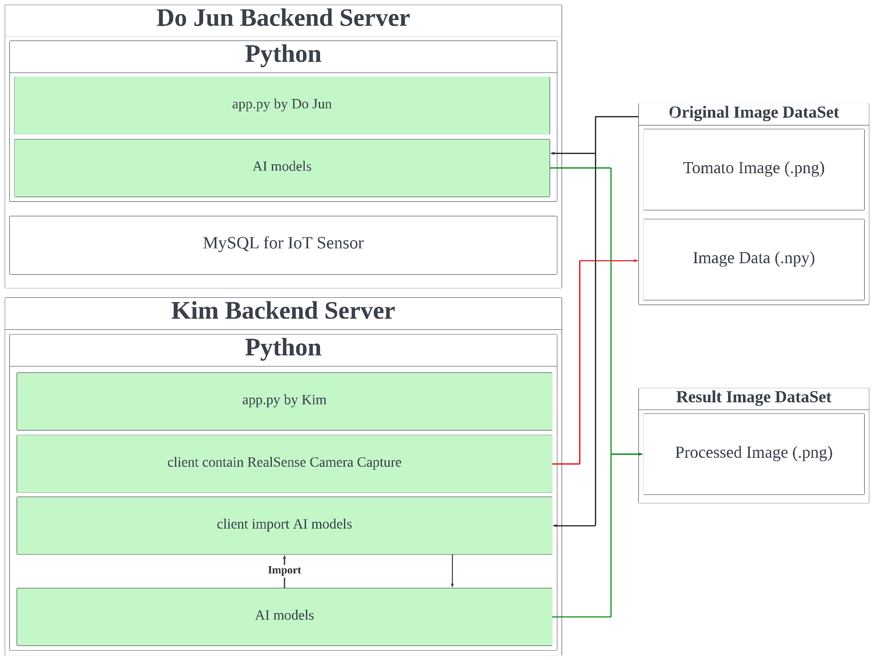
Backend Integrate
This is the system architecture that are working in the current stage of project, we both make a flask server on our computer that running for different function of whole system

Slide 4
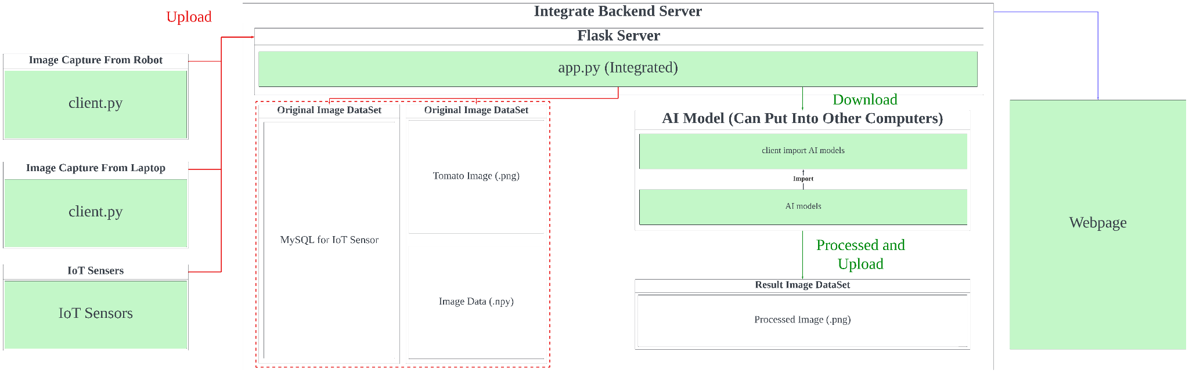
Backend Integrate
Notes:
Make a documentation such as user manual and developer manual
In next 2weeks, show and prepare practical demonstration

Slide 5
Feedback
Start make practical demonstrations
Make a document such as user manual and developer manual

